Slide 1
Attic Cooling System
Harman swaich – Kiryll Parfoynov – Jason li – raj sarai

Slide 2
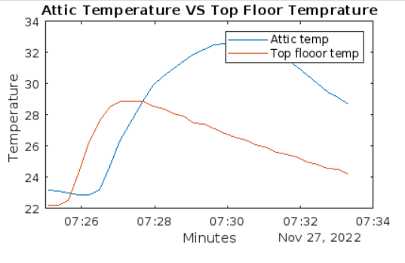
Problem
Poorly ventilated attic area during summer months
Discomfort for occupants inside
Energy consumption of air conditioning unit

Slide 3
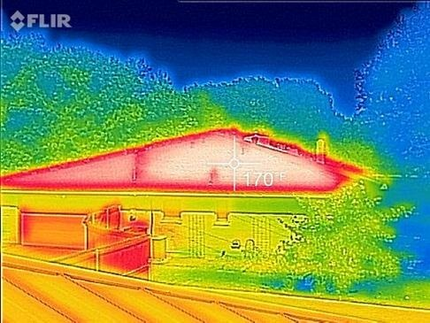
Solutions
More ventilation
Constant airflow
Improve insulation
Lighter roof colour

Slide 4
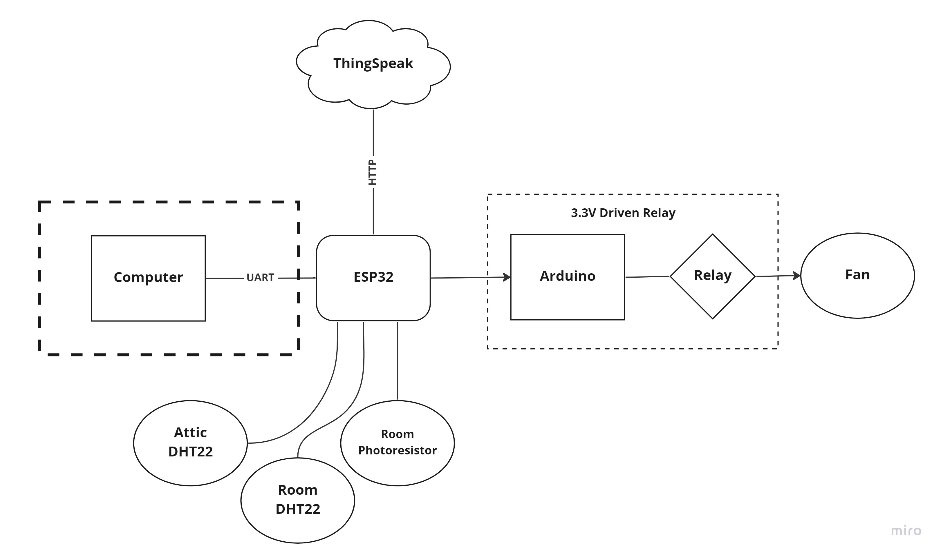
Our Solution – Constant Airflow

Slide 5
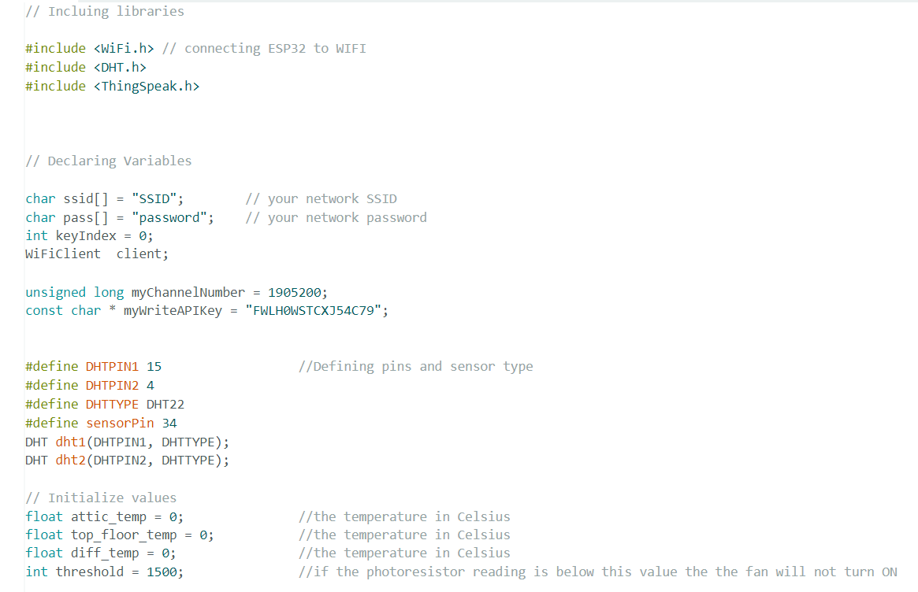
Used Code

Slide 6
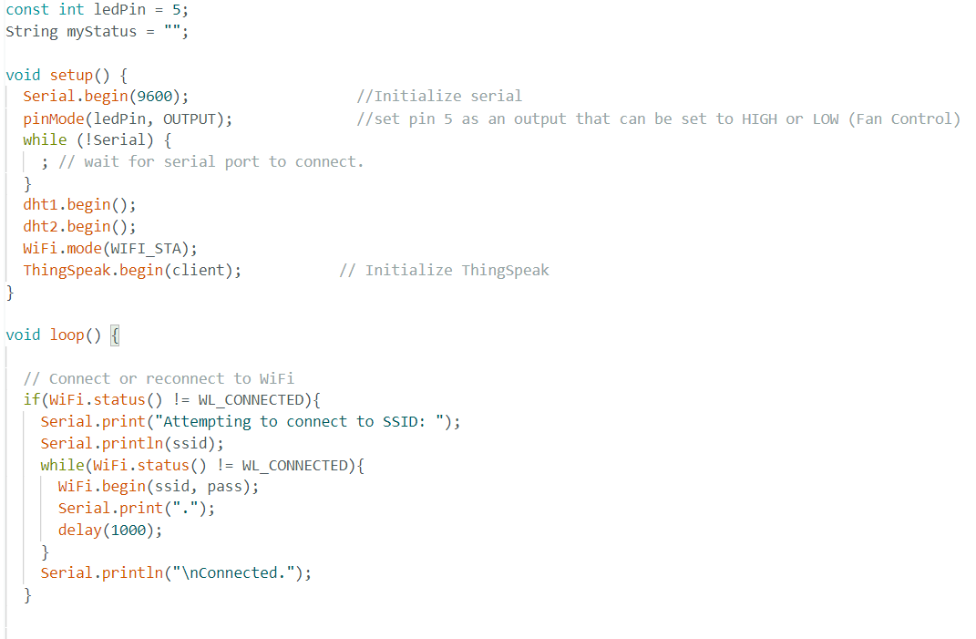
Used Code (cont.)

Slide 7
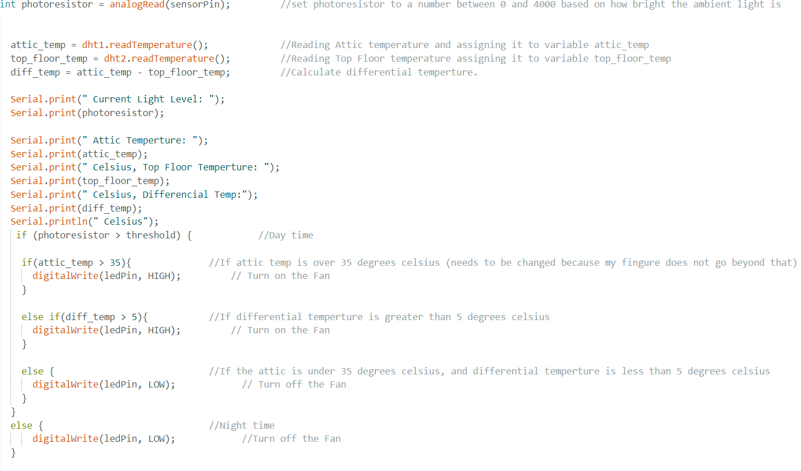
Used Code (cont.)

Slide 8
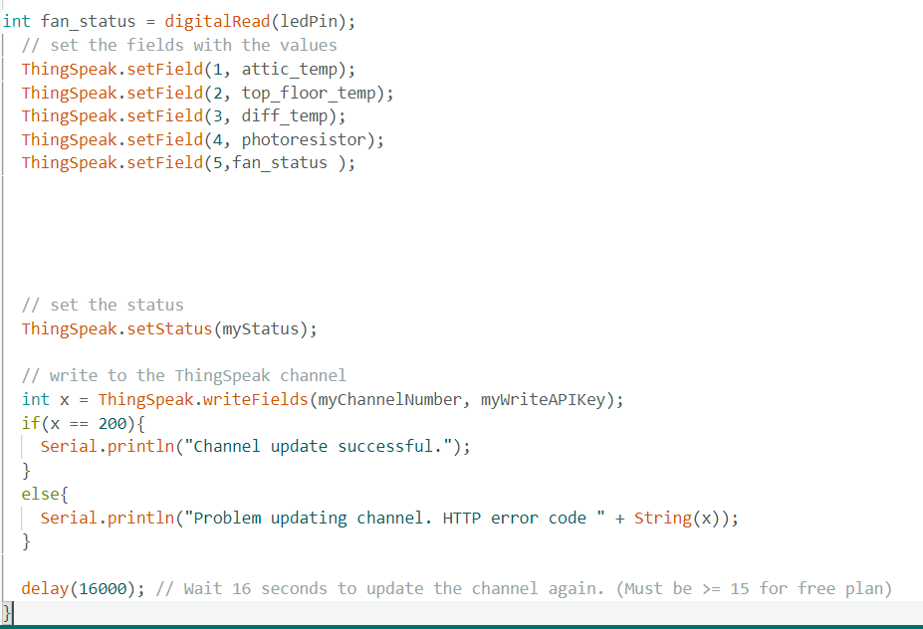
Used Code (cont.)

Slide 9
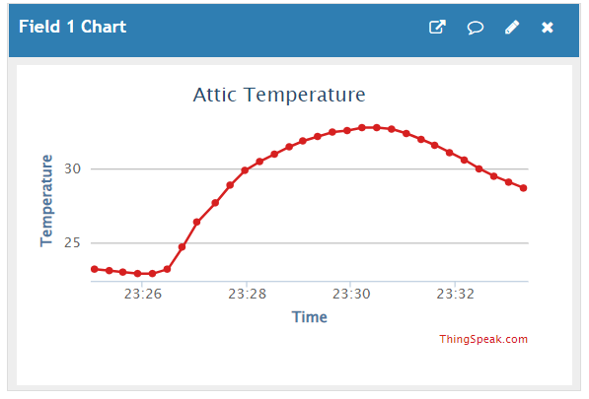
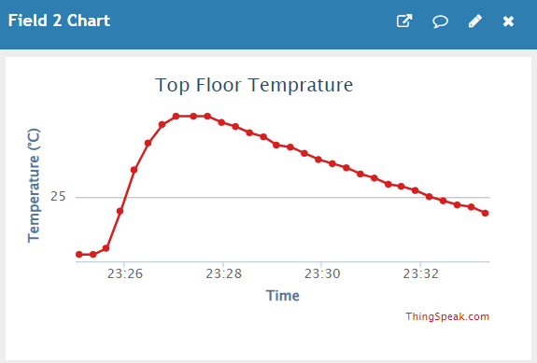
Results Finding

Slide 10
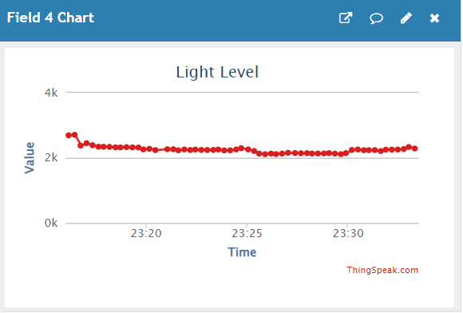
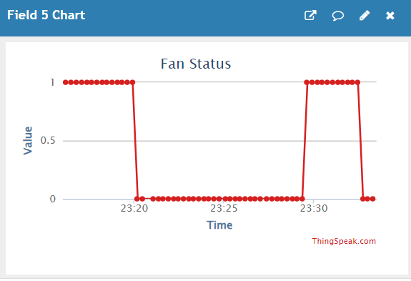
Results Finding (cont.)

Slide 11
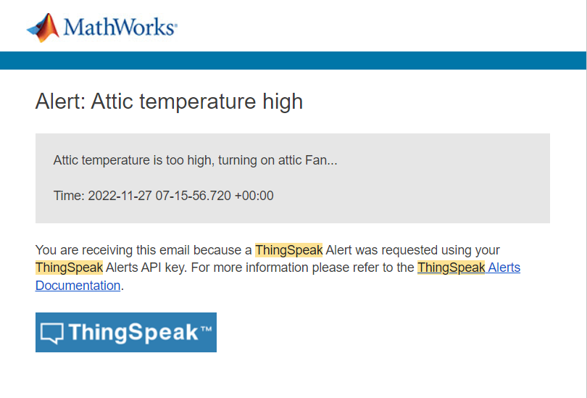
Deliverables
Final report
Oral presentation
Live monitoring to webserver (ThingSpeak)
Email notification
Prototype

Slide 12
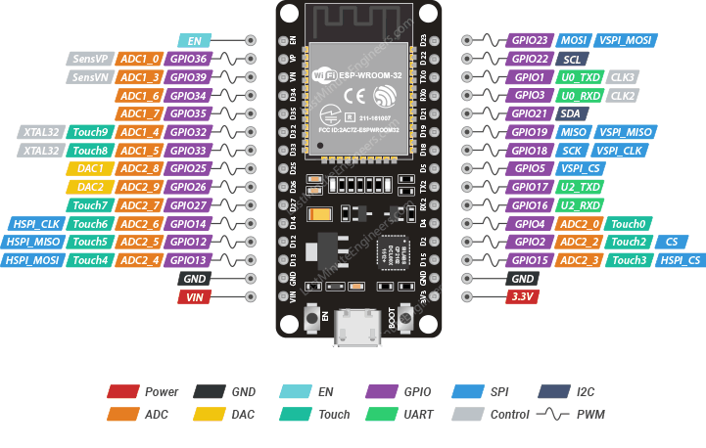
Lessons Learnt
Using the ESP32
Using ThingSpeak
Not being able to use BCIT Wi-Fi

Slide 13
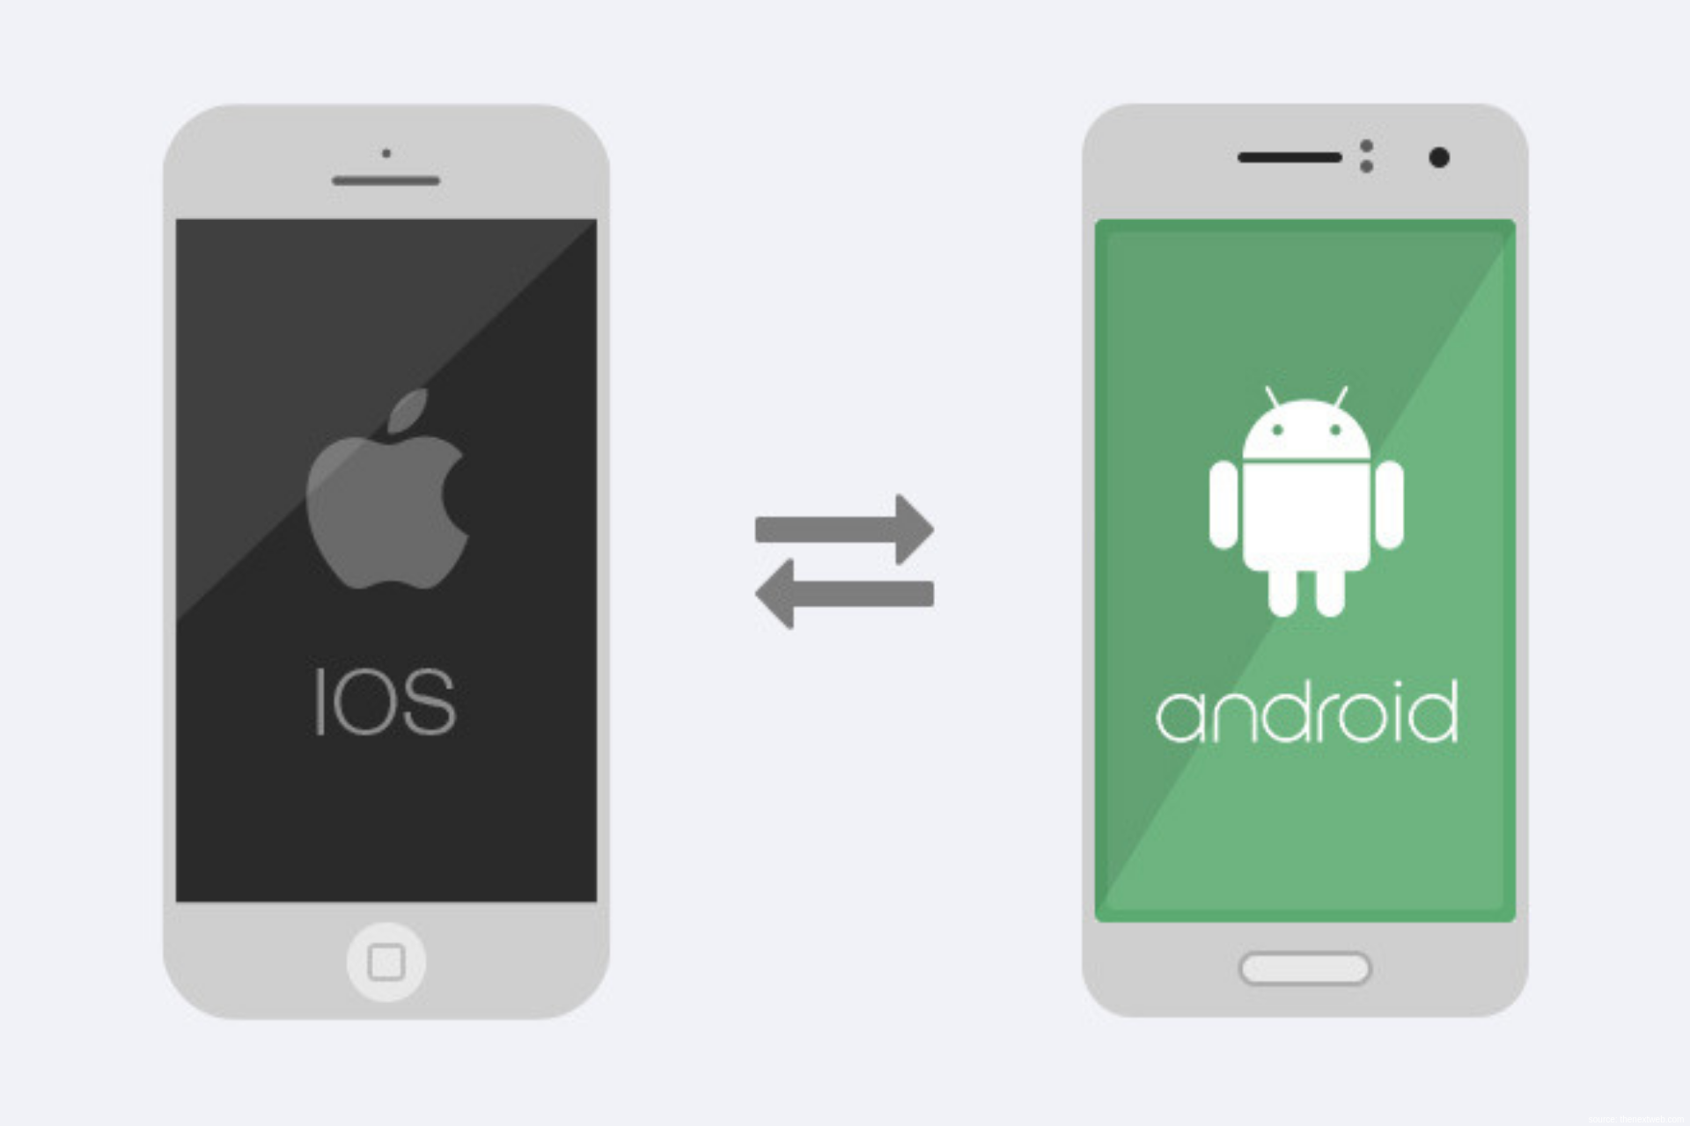
Future Scope
Mobile app to control fan
Implement more security
Better equipment
Improve code
Redundancy

Slide 14
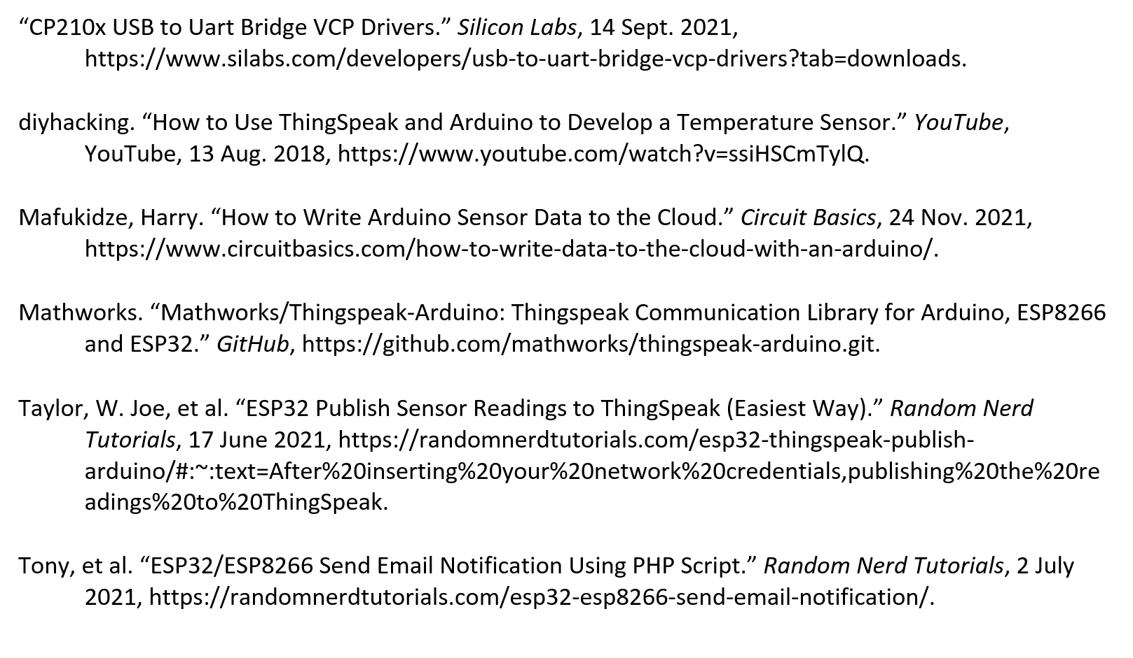
Reference

